Slide 1

Tensor
Mariya Stancheva

Slide 2
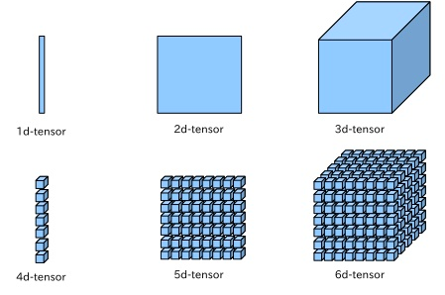
In mathematics, a tensor is an algebraic object related to a vector space and its dual space that can be defined in several different ways, often a scalar, tangent vector at a point, a cotangent vector (dual vector) at a point or a multi-linear map from vector spaces to a resulting vector space. Euclidean vectors and scalars (which are often used in elementary physics and engineering applications where General relativity is irrelevant) are the simplest tensors. While tensors are defined independent of any basis, the literature on Physics often refers to them by their components in a basis related to a particular coordinate system.
Definition

Slide 3
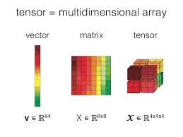
A tensor may be represented as a (potentially multidimensional) array (although a multidimensional array is not necessarily a representation of a tensor, as discussed below with regard to holors). Just as a vector in an n-dimensional space is represented by a one-dimensional array of length n with respect to a given basis, any tensor with respect to a basis is represented by a multidimensional array. For example, a linear operator is represented in a basis as a two-dimensional square n × n array. The numbers in the multidimensional array are known as the scalar components of the tensor or simply its components.
Multidimensional array

Slide 4
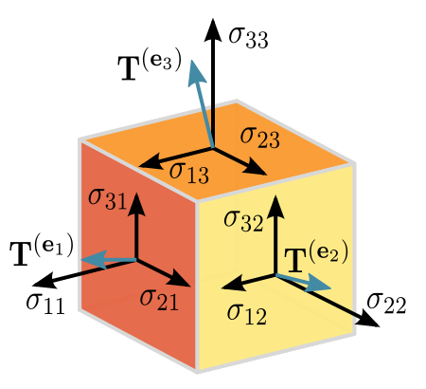
A downside to the definition of a tensor using the multidimensional array approach is that it is not apparent from the definition that the defined object is indeed basis independent, as is expected from an intrinsically geometric object. Although it is possible to show that transformation laws indeed ensure independence from the basis, sometimes a more intrinsic definition is preferred. One approach that is common in differential geometry is to define tensors relative to a fixed (finite-dimensional) vector space V, which is usually taken to be a particular vector space of some geometrical significance like the tangent space to a manifold. In this approach, a type (p, q) tensor T is defined as a multilinear map.
As multilinear maps

Slide 5
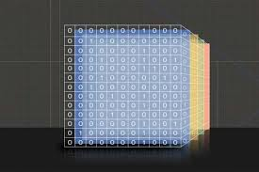
For infinite-dimensional vector spaces, inequivalent topologies lead to inequivalent notions of tensor, and these various isomorphisms may or may not hold depending on what exactly is meant by a tensor (see topological tensor product). In some applications, it is the tensor product of Hilbert spaces that is intended, whose properties are the most similar to the finite-dimensional case. A more modern view is that it is the tensors' structure as a symmetric monoidal category that encodes their most important properties, rather than the specific models of those categories.
Tensors in infinite dimensions

Slide 6
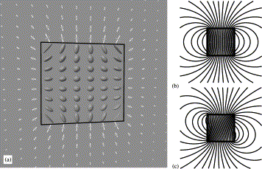
In many applications, especially in differential geometry and physics, it is natural to consider a tensor with components that are functions of the point in a space. This was the setting of Ricci's original work. In modern mathematical terminology such an object is called a tensor field, often referred to simply as a tensor. In this context, a coordinate basis is often chosen for the tangent vector space. The transformation law may then be expressed in terms of partial derivatives of the coordinate functions.
Tensor fields

Slide 7
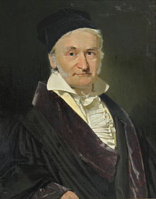
The concepts of later tensor analysis arose from the work of Carl Friedrich Gauss in differential geometry, and the formulation was much influenced by the theory of algebraic forms and invariants developed during the middle of the nineteenth century. The word "tensor" itself was introduced in 1846 by William Rowan Hamilton to describe something different from what is now meant by a tensor.[Note 3] The contemporary usage was introduced by Woldemar Voigt in 1898.
History

Slide 8
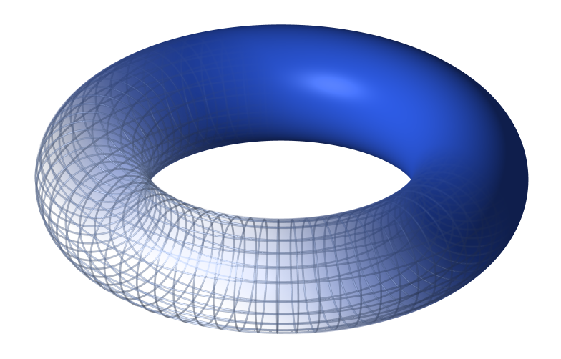
From about the 1920s onwards, it was realised that tensors play a basic role in algebraic topology (for example in the Künneth theorem). Correspondingly there are types of tensors at work in many branches of abstract algebra, particularly in homological algebra and representation theory. Multilinear algebra can be developed in greater generality than for scalars coming from a field. For example, scalars can come from a ring. But the theory is then less geometric and computations more technical and less algorithmic. Tensors are generalized within category theory by means of the concept of monoidal category, from the 1960s.
Roles

Slide 9
END

